Slide 1

AASD 4000
Machine Learning - I
Applied AI Solutions Developer Program

Slide 2
Module 9
ML Algorithms II
Vejey Gandyer

Slide 3
Agenda
Model Building Template
Naïve Bayes
PCA
Gaussian Mixture Models
Benchmarking Algorithms

Slide 4
ML Algorithm
What is it?

Slide 5
What is ML Algorithm ?
ML Algorithm is a series of steps that is used to learn a mapping function that converts raw data into set of rules.
Top ML Algorithms you should be familiar with
Linear Regression
Logistic Regression
Naïve Bayes
K-Nearest Neighbours
Support Vector Machine
Decision Tree
Random Forest
Principal Component Analysis
K-Means
XGBoost
LightGBM

Slide 6
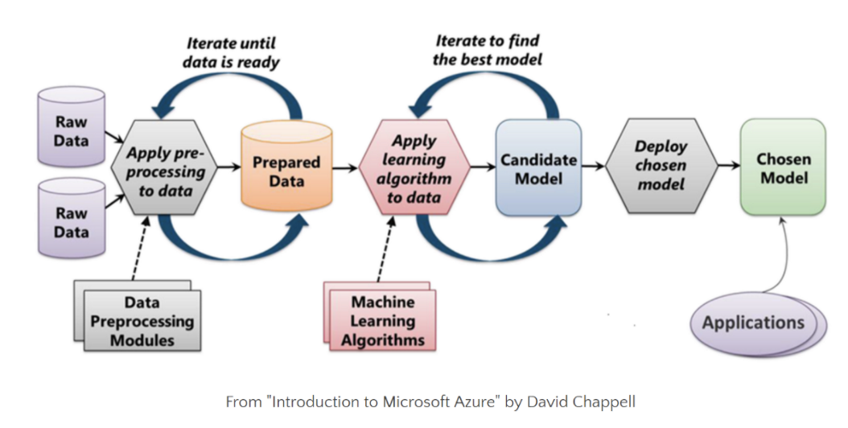
Machine Learning Process

Slide 7
Model Building Template
Choose hyperparameters
Train model
Choose an algorithm
Use / Apply model
Prepare the data

Slide 8
Naïve Bayes

Slide 9
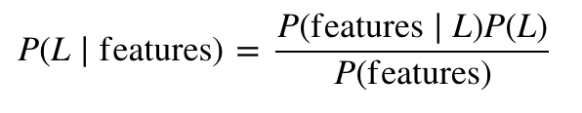
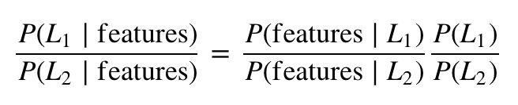
Naïve Bayes
Extremely fast
Very few tunable parameters
Quick-and-dirty baseline algorithm for any classification problem
Generative Classification
Bayes Theorem

Slide 10
Naïve Bayes
If we make very naive assumptions about the generative model for each label, we can find a rough approximation of the generative model for each class, and then proceed with the Bayesian classification
Gaussian Naïve Bayes – assumption is that data from each label is drawn from a simple Gaussian distribution
Multinomial Naïve Bayes - assumption is that data from each label is drawn from a simple Multinomial distribution

Slide 11
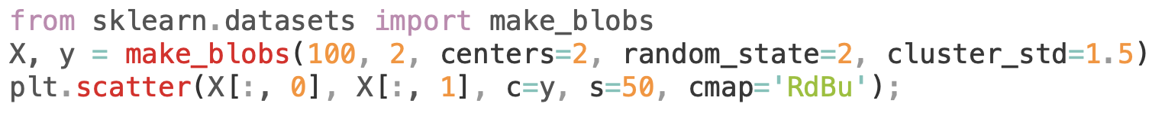
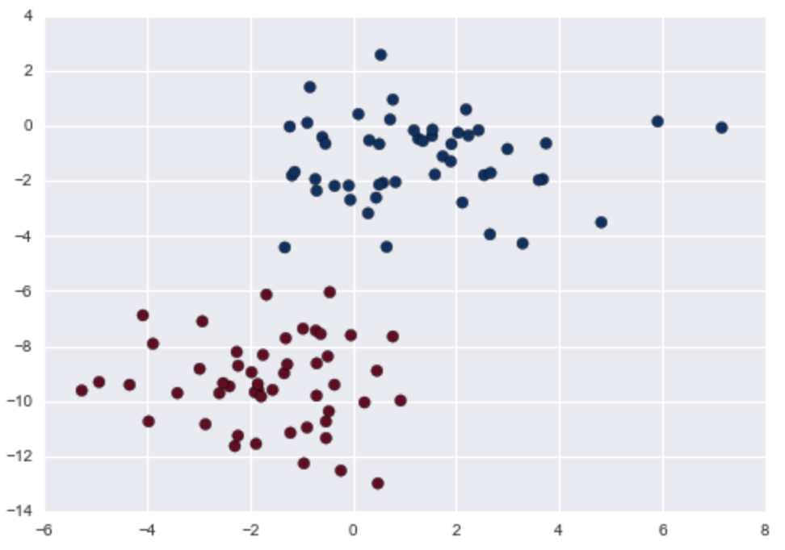
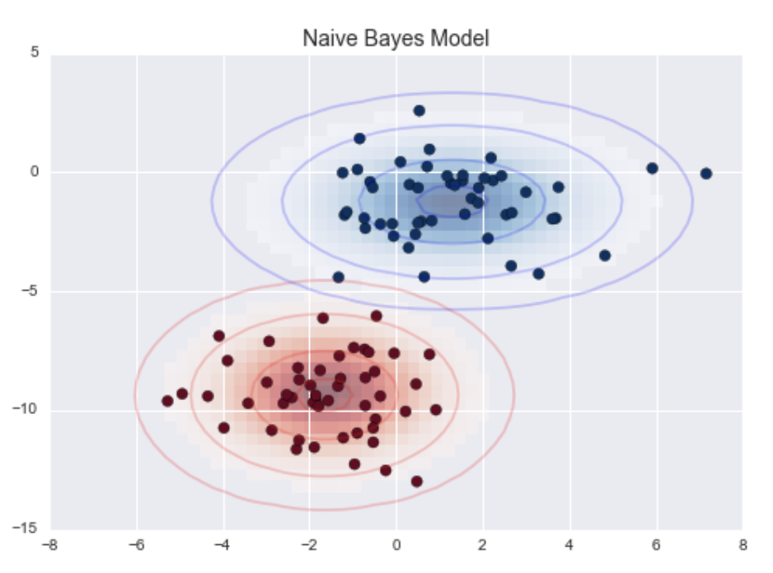
Gaussian Naïve Bayes
Assumption: Data from each label is drawn from a simple Gaussian distribution.

Slide 12
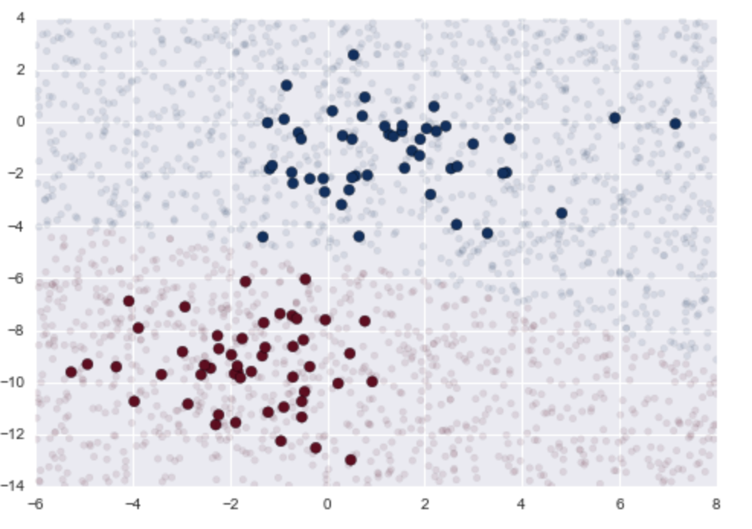
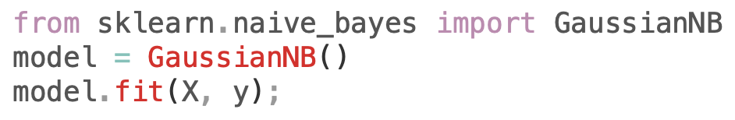
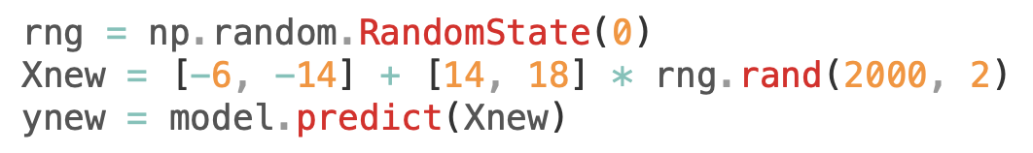
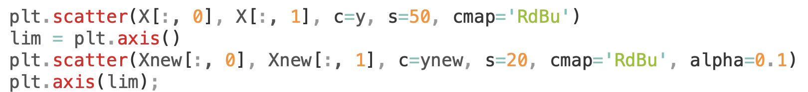
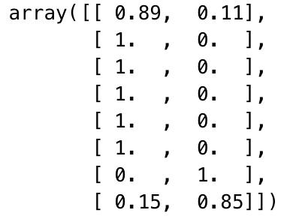
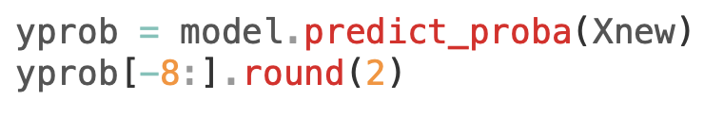
Gaussian Naïve Bayes

Slide 13
Naïve Bayes
Pros
They are extremely fast for both training and prediction
They provide straightforward probabilistic prediction
They are often very easily interpretable
They have very few (if any) tunable parameters
They perform better
When the naive assumptions actually matches the data
For very well-separated categories, when model complexity is less important
For very high-dimensional data, when model complexity is less important

Slide 14
Principal Component Analysis (PCA)

Slide 15
Principal Component Analysis (PCA)
Unsupervised algorithm
Dimensionality Reduction
Uses
- Visualization tool
- Noise filter
- Feature Extractor

Slide 16
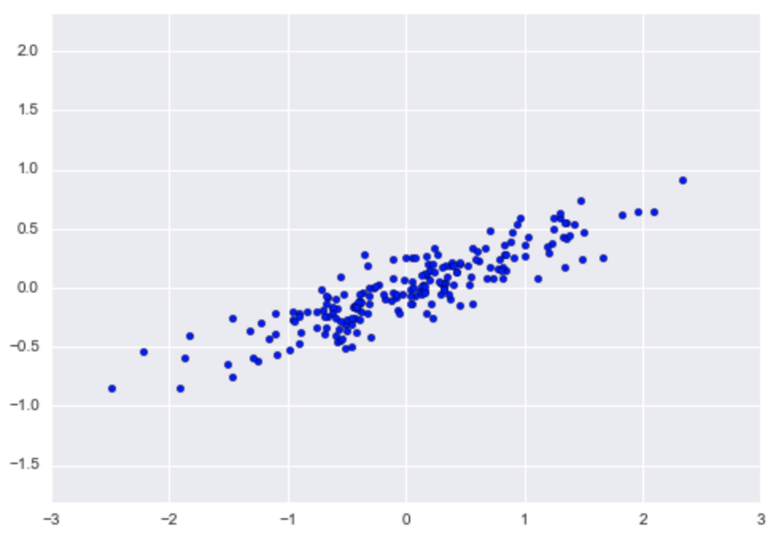
Principal Component Analysis (PCA)
Attempts to learn the relationship between X and y values
Relationship is defined by finding a list of prinicpal axes in the data

Slide 17
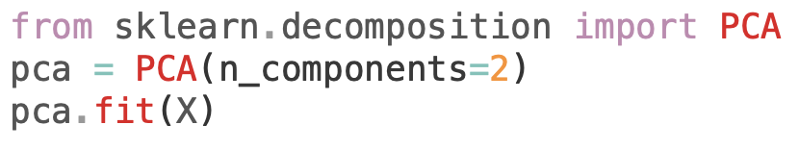
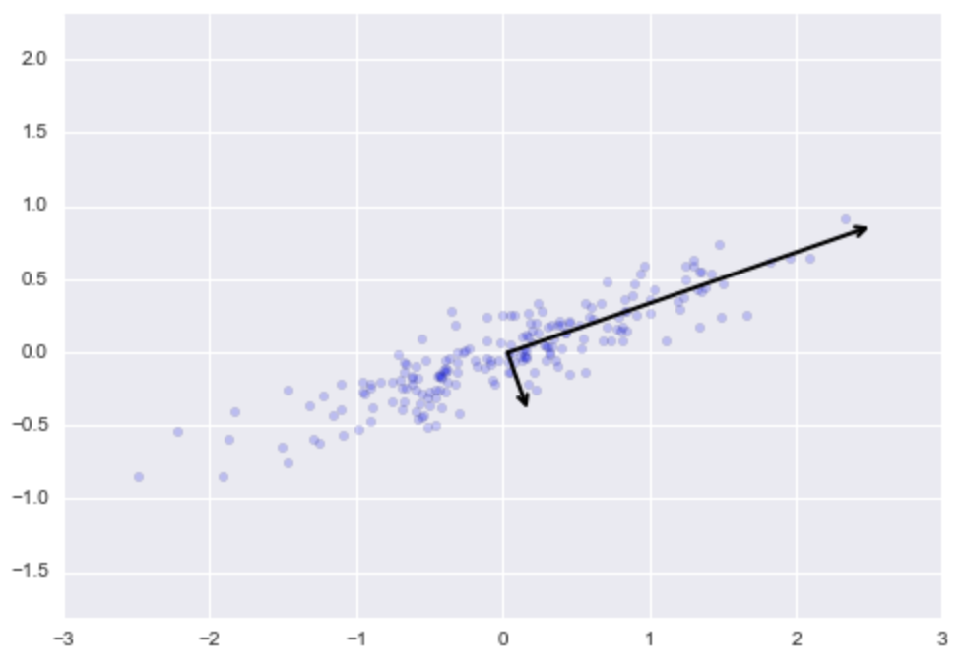

Principal Component Analysis (PCA)

Slide 18
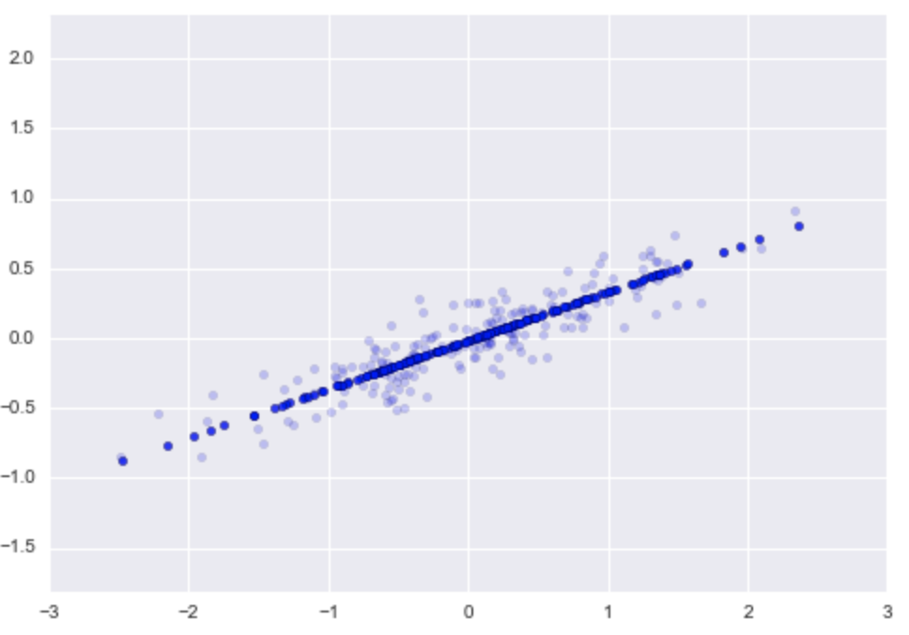
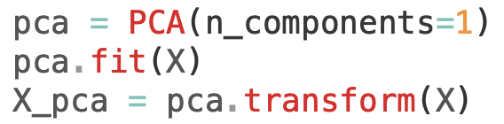
PCA as Dimensionality Reduction
Zeroing out one or more of the smallest principal components resulting in a low-dimension projection of data that preserves the maximal data variance

Slide 19
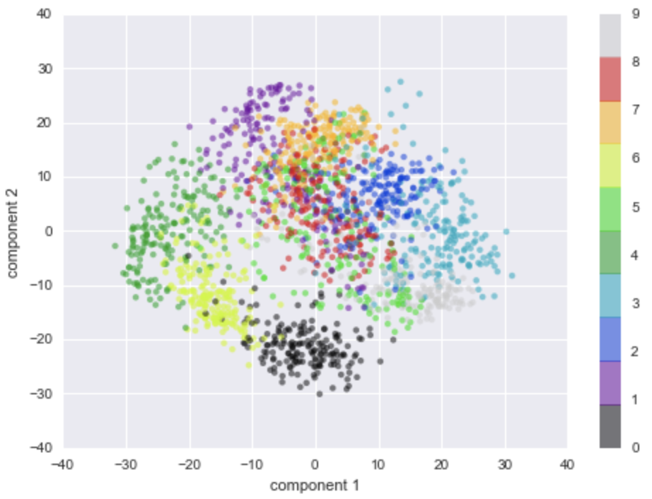
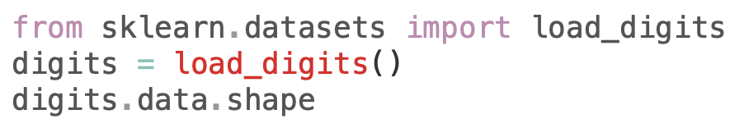
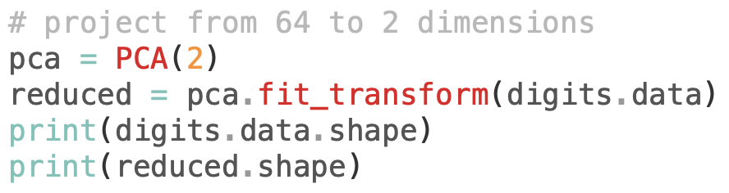





PCA as Visualization tool

Slide 20
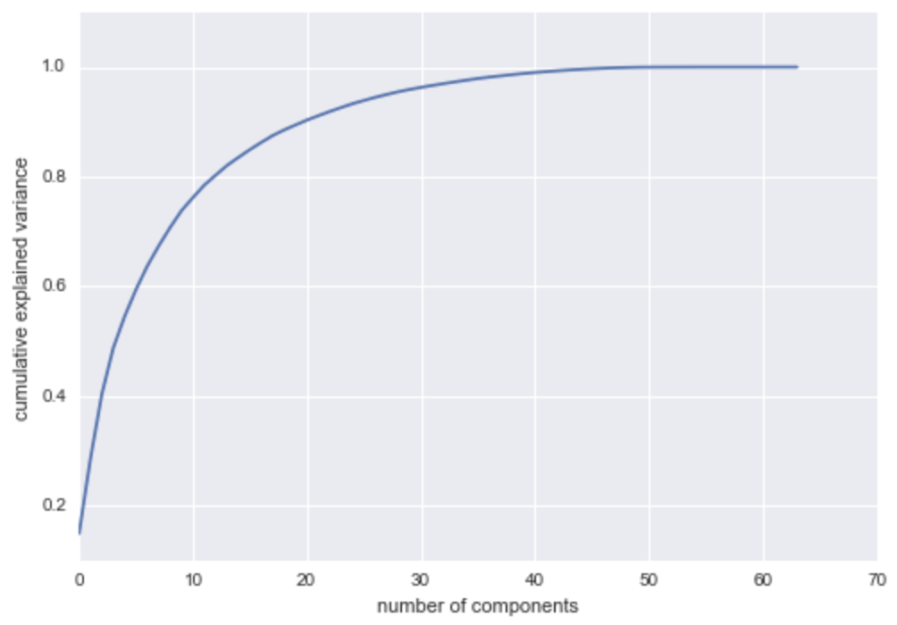
Choosing the number of components
Stop here because it hits 100%
10 components contains 75% of variance
50 components contain 100% of variance
Optimal:
20 components explain 90% of variance

Slide 21
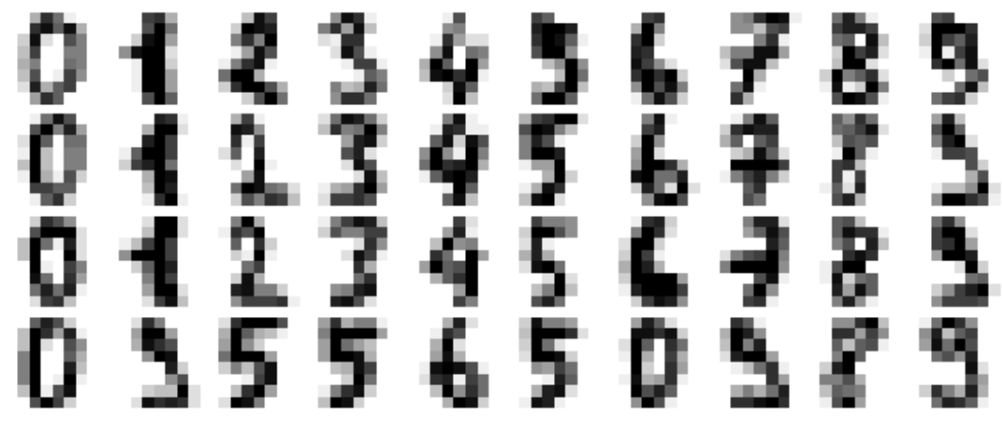



PCA as Noise Filtering
Any components with variance larger than the effect of the noise should be relatively unaffected by the noise
If data is reconstructed using only the largest subset of principal components, it will keep the signal and throw out the noise.

Slide 22
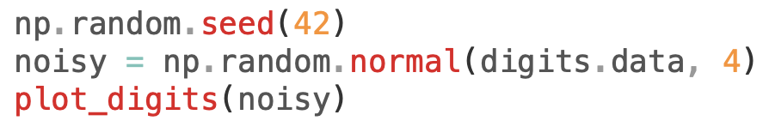
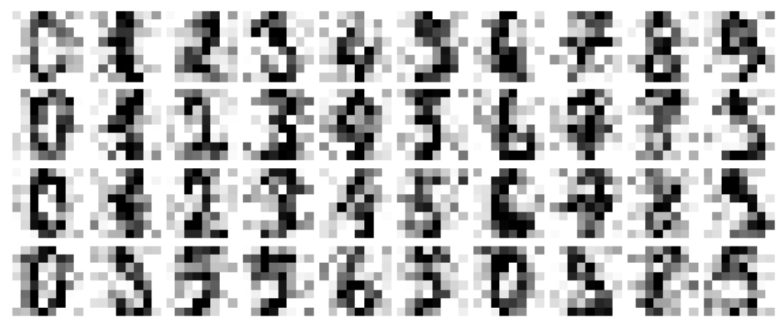
PCA as Noise Filtering
Adding random noise to the data

Slide 23
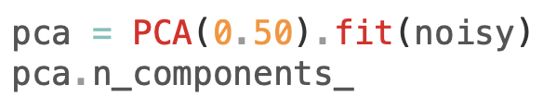
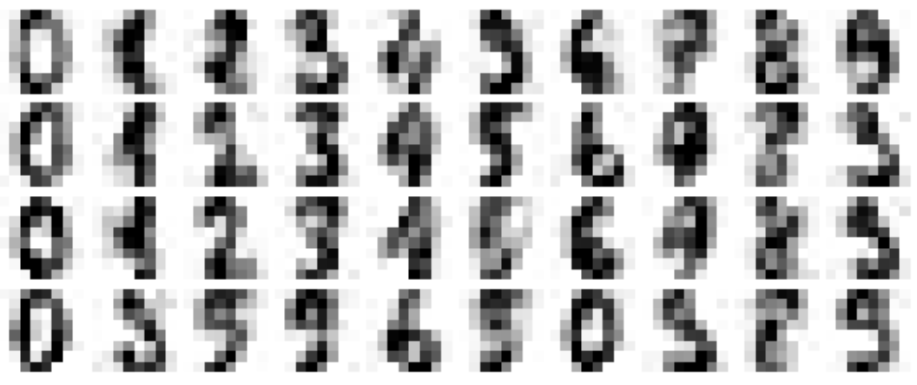
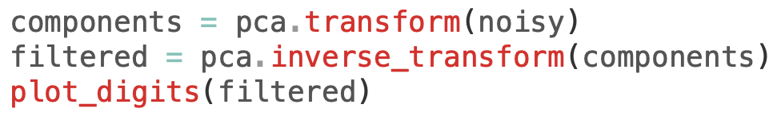
PCA as Noise Filtering

Slide 24
PCA
Start with PCA to visualize the relationship between points to understand
- the main variance
- the intrinsic dimensionality by plotting explained variance ratio
Cons
- affected by outliers in the data

Slide 25
Case Study: Eigenfaces
Dataset: Sklearn built-in LFW dataset
Notebook: ML07_PCA_Example.ipynb
Steps:
Download the dataset
Explore the dataset
Prepare the dataset
Build the model
Predict on testing data
Report insights

Slide 26
Gaussian Mixture Models (GMM)

Slide 27
Gaussian Mixture Models (GMM)
Unsupervised algorithm
Searches for a pre-determined number of clusters within an unlabeled multidimensional dataset
Two main assumptions
- Cluster center is arithmetic mean of all points belonging to the cluster
- Each point is closer to its own cluster center than other cluster centers

Slide 28
Case Study: Handwritten Digits
Dataset: Digits dataset
Notebook: ML09_GMM_Example.ipynb
To do:
Download the dataset
Explore the dataset
Prepare the dataset
Build the model
Predict on testing data
Report insights

Slide 29
Benchmarking Algorithms
Task 10: Benchmark all the algorithms we've seen so far for a specific classification problem

Slide 30
Further Reading
Scikit-learn documentation
https://scikit-learn.org/
Python Data Science Handbook by Jake Vanderplas

